Slide 1

Hospital Management system

Slide 2

Our team members
Name | Registration
Sadia Islam Khan | 22101096
Afia Zahin | 22101010
Mahmuda Sultana | 22101001
Lamia Qurishy | 22101020
Md. Khaleduzzaman | 22101022

Slide 3
TABLE OF CONTENTS
01
Description
04
Relationship
02
ER Diagram
05
Query
03
Schema Diagram
06
CEP Mapping

Slide 4

description
Our project centers on the creation of a sophisticated Hospital Management System, designed to optimize workflows within healthcare facilities and improve patient care delivery. Leveraging the comprehensive functionalities of SQL server management, we have meticulously crafted an architecture comprising 10 essential tables in our database. Our primary objective is to engineer a robust database management system using SQL that ensures uninterrupted service for hospitals and medical institutions.

Slide 5

ER Diagram
02

Slide 6
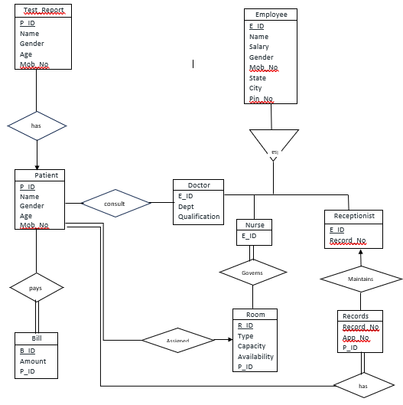
ER Diagram

Slide 7
Schema diagram
03

Slide 8
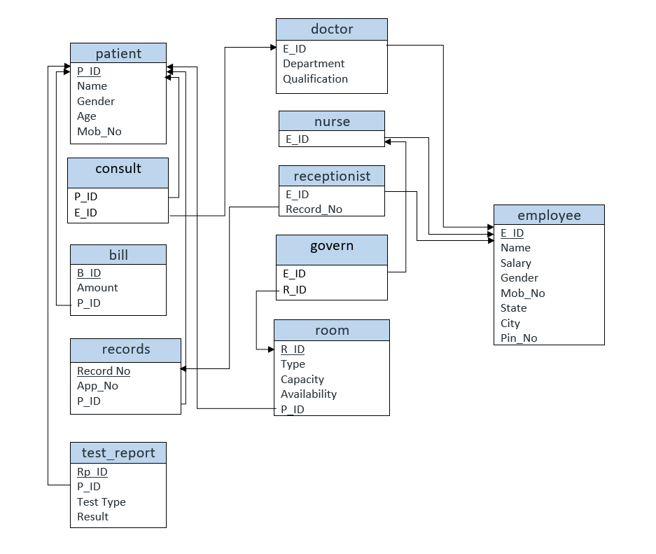
Schema diagram

Slide 9
04 Relationship
Relationships sets:
Entities have some relationship with each other. Relationships define how entities are associated with each other.
Let’s Establishing Relationships between them are:
Patient consults Doctor.
Employee have roles as a nurse, doctor and receptionist within the hospital.
Nurse governs rooms.
Patient assigned rooms during their stay at hospital.
Receptionist maintains hospital records.
Patient has test report.
Relationships Between These Entities
1. Patient – Doctor Relationship
A patient can have a relationship with one or more doctors for consultations or treatments.
A doctor can have multiple patients.
This is a Many-to-Many (Patient-to-Doctor) as multiple Patient can visit multiple Doctor.

Slide 10
04 Relationship
2. Nurse – Rooms Relationship
A nurse can be assigned to one or more rooms during their shift.
A room can have multiple nurses assigned to it over different shift.
This is a many-to-many relationship between nurses and rooms, each nurse can be assigned to multiple rooms, and each room can have multiple nurses assigned to it.
3. Receptionist – Records Relationship
A receptionist manages records which could include patient records, appointment schedules, or other administrative documents.
A record can be managed by one or more receptionists.
This is a many-to-many relationship between receptionists and records, each receptionist can manage multiple records, and each record can be managed by multiple receptionists.

Slide 11
04 relationship
4. Patient – Bills Relationship
One patient can have multiple bills.
One bill is associated with only one patient.
This is a one-to-many relationship between patients and bills, each patient can have multiple bills, but each bill belongs to only one patient.
5. Patient – Test Report Relationship
One patient can have multiple test reports.
One test report is associated with only one patient.
This is a one-to-many relationship between patients and test reports, each patient can have multiple test reports, but each test report belongs to only one patient.
6. Rooms – Patient Relationship
One room can accommodate multiple patients over time.
One patient occupies one room at a time.
This is a one-to-many relationship between rooms and patients, each room can accommodate multiple patients, but each patient occupies only one room at a time.

Slide 12
04 relationship
7. Patient – Records Relationship
Patients has records.

Slide 13

Query
05

Slide 14

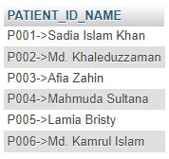
1.Show a text concatenation of patient IDs and patient name.

Slide 15
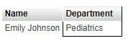
2.Show doctor name whose department is Pediatrics.
SELECT E.Name ,D.Department FROM doctor D,employee E WHERE E.E_ID=D.E_ID AND D.Department="Pediatrics";

Slide 16
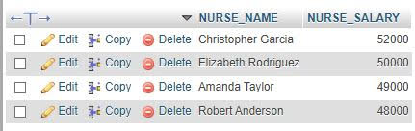
3.Sort the salary of nurse from the highest to the lowest.
SELECT E.Name AS NURSE_NAME,E.SALARY AS NURSE_SALARY FROM nurse N,employee E WHERE E.E_ID=N.E_ID ORDER BY E.Salary DESC;

Slide 17

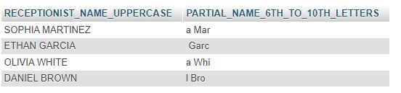
4.Show the receptionists name in uppercase and its partial name containing 6th and 10th letters.

Slide 18

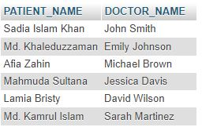
5.Show the patients name under doctor name.

Slide 19
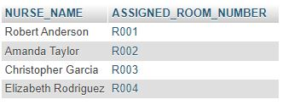
6.Show the nurse name with assigned room number.
SELECT E.Name AS NURSE_NAME,R.R_ID AS ASSIGNED_ROOM_NUMBER FROM employee E,nurse N,room R,govern G WHERE E.E_ID=N.E_ID AND N.E_ID=G.E_ID AND G.R_ID=R.R_ID;

Slide 20
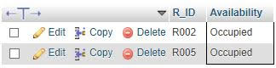
7.Show the room IDs where room status is “occupied” (using subquery).
SELECT R_ID,Availability FROM room WHERE Availability ="Occupied";

Slide 21
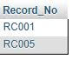
8.Show Record No maintained by Sophia Martinez.
SELECT R.Record_No FROM `employee` E, receptionist R, records Rd WHERE E.Name="Sophia Martinez" AND E.E_ID=R.E_ID AND R.Record_No=Rd.Record_No;

Slide 22
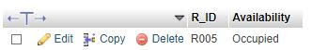
9.Show room ID and Availability, status for room assigned for Lamia Brishty.
SELECT R.R_ID,Availability FROM `patient`P,room R WHERE P.Name="Lamia Bristy" AND P.P_ID=R.P_ID;

Slide 23
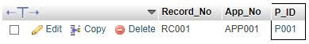
10.Show the appointment number along with Appointment Number and P_ID for Sadia Islam Khan.
SELECT R.Record_No,R.App_No,R.P_ID FROM records R , patient P WHERE P.Name="Sadia Islam Khan" AND P.P_ID=R.P_ID;

Slide 24
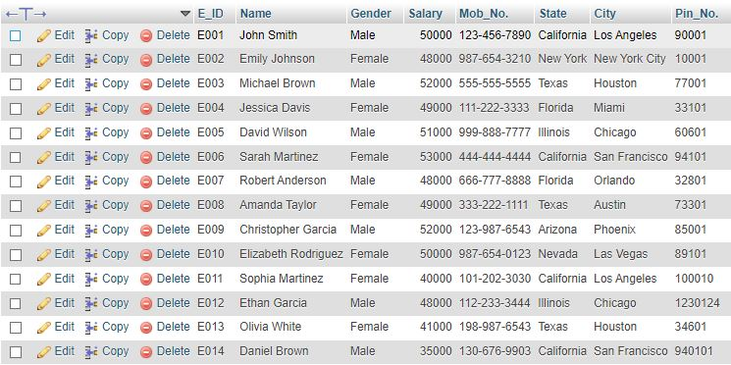
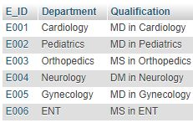
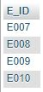
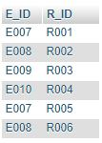
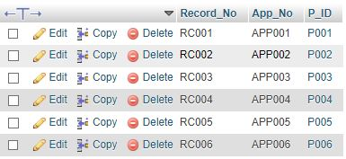
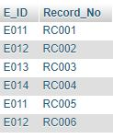
Table Values
doctor
nurse
patient
governs
receptionist
record

Slide 25
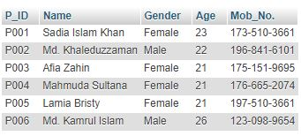
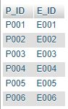
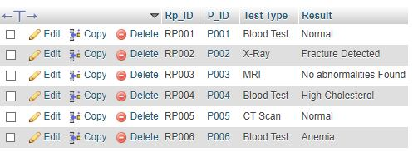
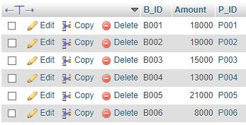
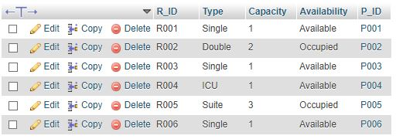
Test_Report
patient
consult
room
bill

Slide 26

06
CEP Mapping

Slide 27
Key points of mapping knowledge profile
K3: Engineering Fundamentals
K5: Engineering design
K6: Engineering practice
K7: Comprehension

Slide 28
POINTS THAT WE HAVE USED FROM KNOWLEDGE PROFILE
K3 : Engineering Fundamentals
The project required understanding of database fundamentals in order to formulate for the model using SQL server and XAMPP.
K5: Engineering design
ER Diagram and Schema Diagram were used to create the model.
K6: Engineering practice
Use of modern tool like SQL Server Management Studio and XAMPP control panel.
K7: Comprehension
Allows the Admin and employee of hospital to efficiently find all employee and patient data so that they don’t have to worry about any information.

Slide 29
Key points of mapping complex engineering problem
P1: Depth of knowledge required
P3: Depth of analysis required
P6: Extent of stakeholder
P7: Interdependence

Slide 30
Points we have used from complex engineering problem
P1: Depth of knowledge required
Cannot be resolved without in-depth knowledge of engineering at the level of one or more Database fundamentals (K3), ER diagram & Schema diagram (K5), use of SQL server to implement SQL (K6) and lastly the impact on society (K7).
P6: Extent of stakeholder
Diverse groups of stakeholders were involved in the project as many of them needed doctor, employee, room, cabin, patient etc. information.

Slide 31
Key points of mapping complex problem activity
A1: Range of Resources
A4: Consequences for society and Environment
A5: Familiarity

Slide 32
Points we have used from complex engineering problem
A1: Range of Resources
Diverse recourses were required throughout the project. These include:
→ Information: Data of all types of users in the database like boarder, admin etc.
→ Technology: SQL Server to manage the database
→ Equipment: Personal Computer
→ People: Users, developers.
→ Money.
A4: Consequences for society and Environment
The project would allow admin who are looking for a employee information, also want to know the doctors, nurse. For example, admin finding the doctors salary, also he increasing salary of any employee. Also people easily find their patient from receptionist and receptionist take the information in patient table and many more.

Slide 33

Thank you!

